Slide 1
Customer Data Analysis:
TK Paddles
Sapir Carlo Dooley, Emily Gill, Austin Pigg, Sedrick Utt

Slide 2

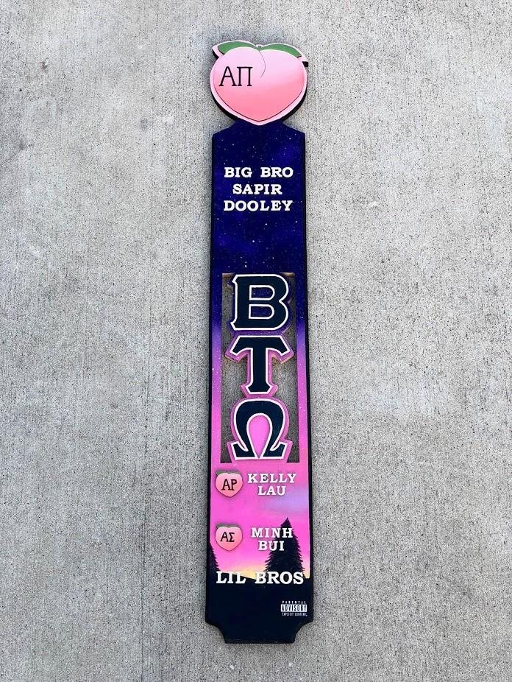

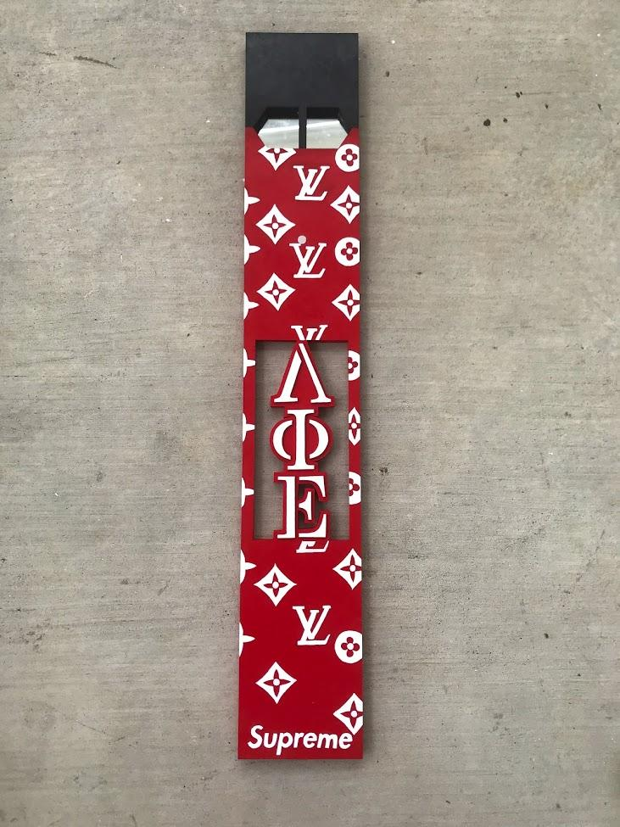
Founded in 2017, TK Paddles is a College Station based business that provides custom-made Greek Fraternity and Sorority paddles across the US
Instagram: @ tk_paddles
Instagram: @ tk_paddles
Instagram: @ tk_paddles
Notes:
Emily

Slide 3
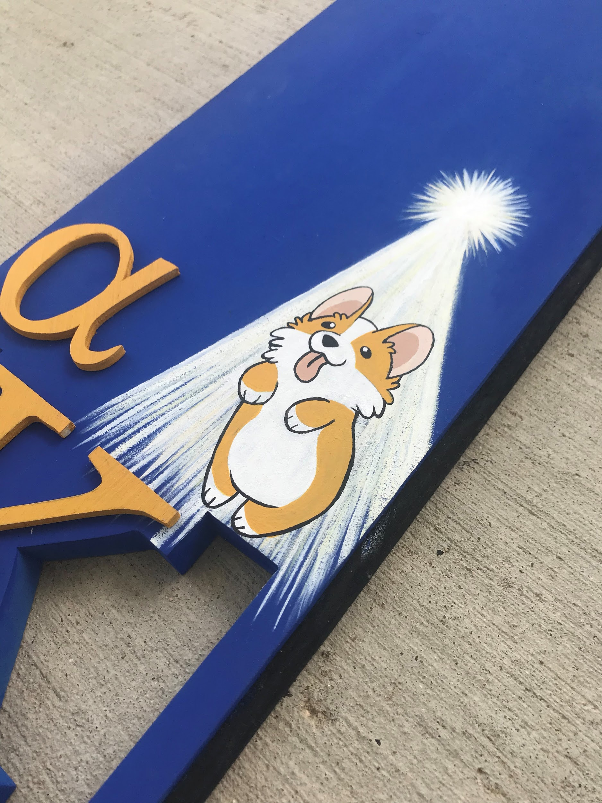
Background Information
Across the United States, there are hundreds of individual led Greek organizations, including two or more “subchapters” of each branch.
Within these groups, a little over a hundred are of Asian Pacific Islander Desi American (APIDA) backgrounds.
An important tradition that is upheld by these organizations is the practice of gifting decorative paddles adorned with specific organizational letters and other customizations.
Instagram: @ tk_paddles
Notes:
Emily

Slide 4

Affinity Licensing
Affinity Licensing is a full-service trademark licensing firm that combines over 100 years of collegiate, athletic and fraternal and association licensing expertise
AIPIDA organizations that are affiliated with this business strictly purchase through this company
Notes:
Emily

Slide 5
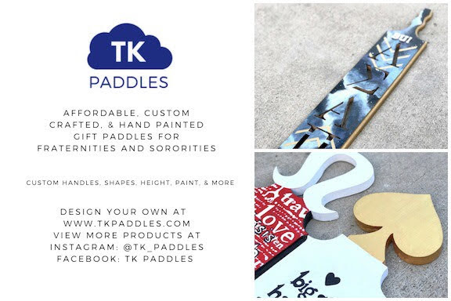
Hypothesis
If the proportion of greek organizations that have the affinity license exceeds 70%, then it would be profitable and beneficial for TK Paddles to obtain this license.
Notes:
Carlo

Slide 6
Methods
Research area included the entirety of the contiguous United States, with specific data points collected at individual universities.
Data was gathered manually through Wikipedia and the list found in the National Asian Pacific Islander Desi American (APIDA) Panhellenic Association, organization’s specific websites and social media, the “American Asian Greek Survey” and the Affinity licensing website.
4 study groups were analyzed: 2018 customers, 2019 customers, 2020 customers and potential future customers.
Attributes such as organization name, locations, profit, member count, history and affinity license were analyzed.
Notes:
Carlo

Slide 7
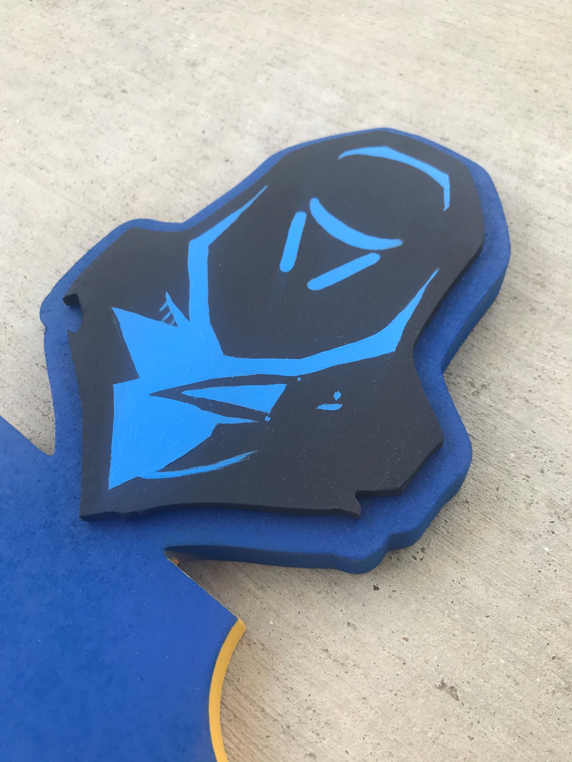
Software Used
The dates of the data were cleaned using Python 3’s datetime package in Jupyter Notebook
Maps and data sets were made using R software
Instagram: @ tk_paddles
Notes:
Carlo

Slide 8
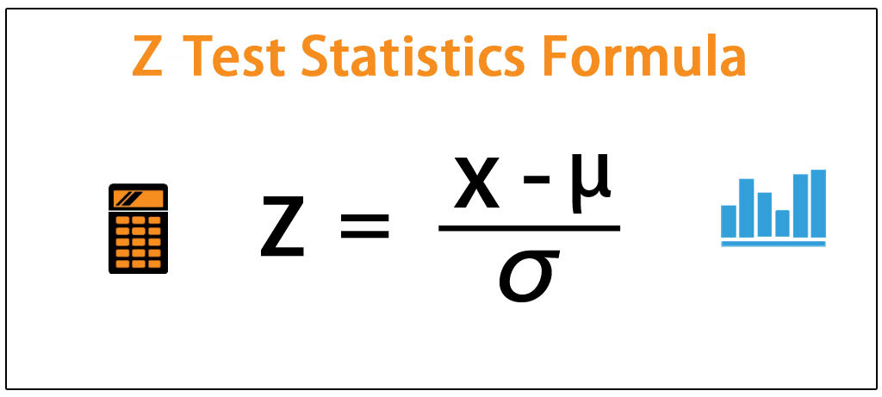
Inferential Statistics
Researchers performed a Z Test of future customer data to see if the proportions of organizations with a membership of over 100 that have the Affinity License is over 2/3rds to determine if TK Paddles should obtain this license.
Results were a p-hat of 0.7160494 and a 95% confidence interval of 0.6178523 to 0.8142464
71.6% of APIDA organizations have the affinity license.
Notes:
Austin

Slide 9
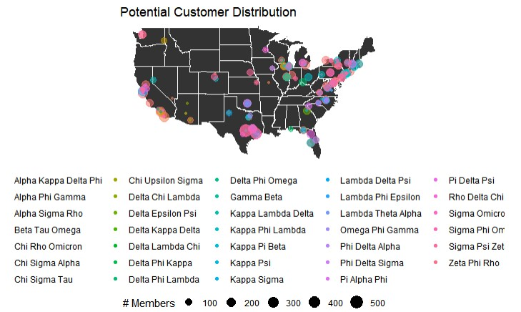
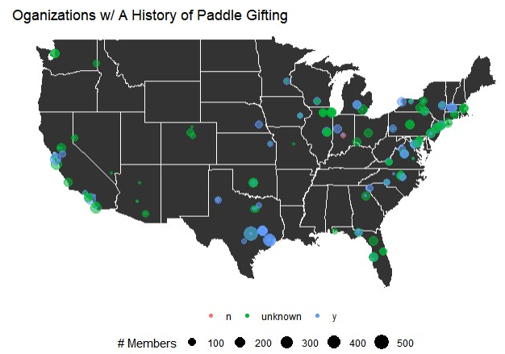
Results
Notes:
Austin

Slide 10
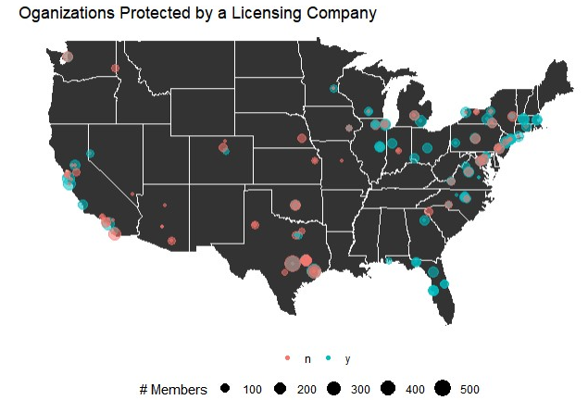
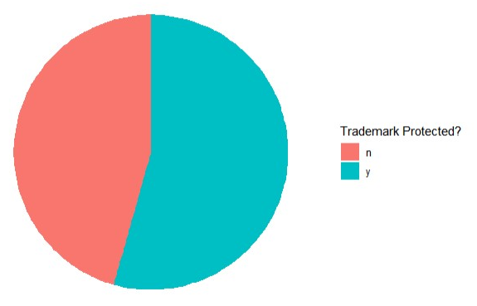
Results
Notes:
Austin

Slide 11
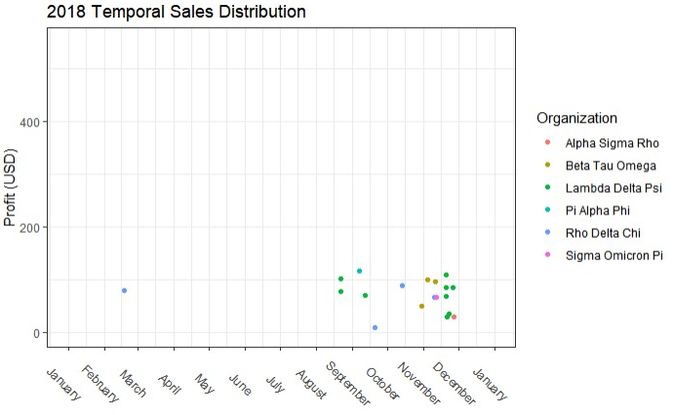
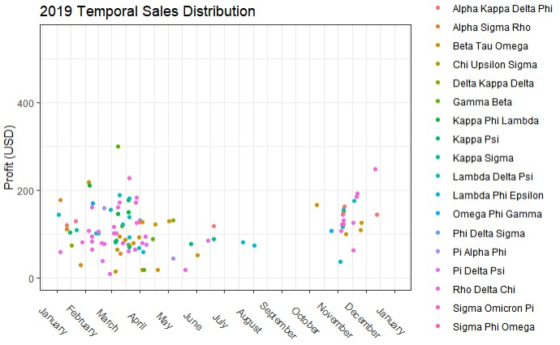
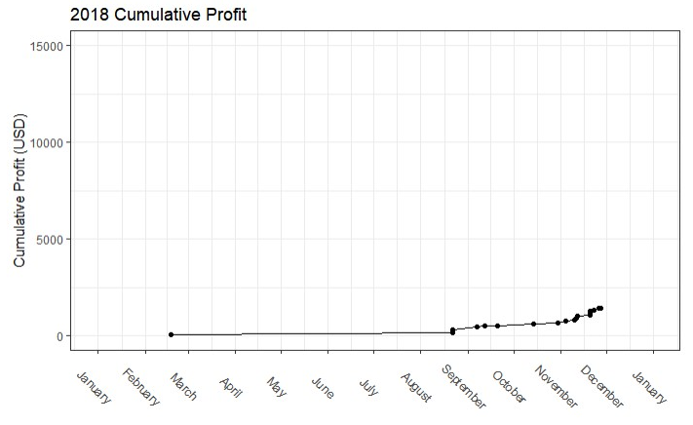
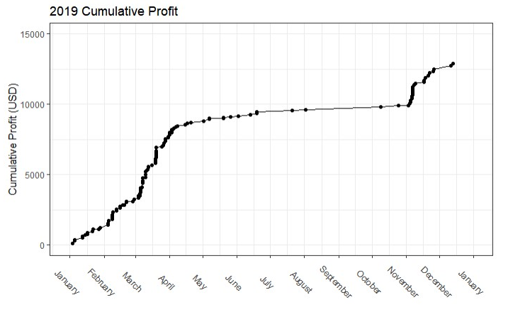
Results
Notes:
Sedrick

Slide 12
Conclusion
TK Paddles should obtain Affinity license
Limitations
Lack of existing relevant research
Future Study Improvements
Percent of Affinity-licensed organizations that take part in paddle-gifting
Multiple licensing firms
Instagram: @ tk_paddles :)
Notes:
Sedrick

